Slide 1
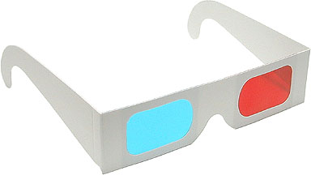
Whose pair of 3D glasses is it?
It’s Mary’s pair of 3D glasses.
a pair of 3D glasses
MARY

Slide 2
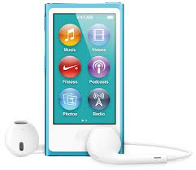
Whose ipod is it?
It’s John’s ipod.
an ipod
John

Slide 3
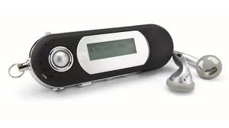
Whose Mp3 player is it?
It’s Chrissie’s Mp3 player.
an Mp3 player
Chrissie

Slide 4
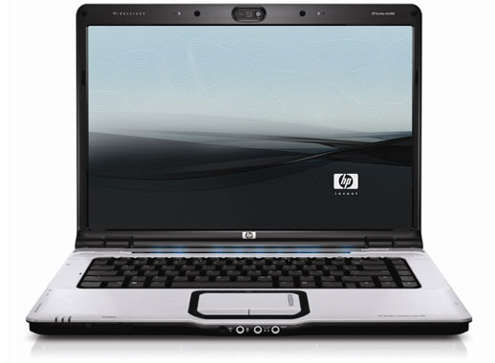
Whose laptop is it?
It’s Max’s laptop.
a laptop
Max

Slide 5
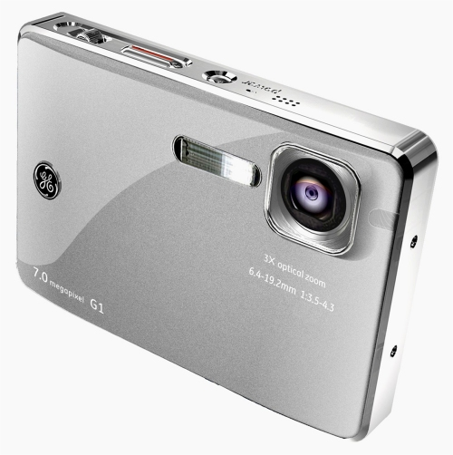
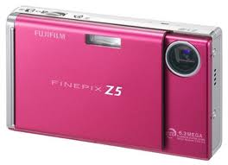
Whose digital cameras are they?
They are Bob’s digital cameras.
digital cameras
Bob

Slide 6
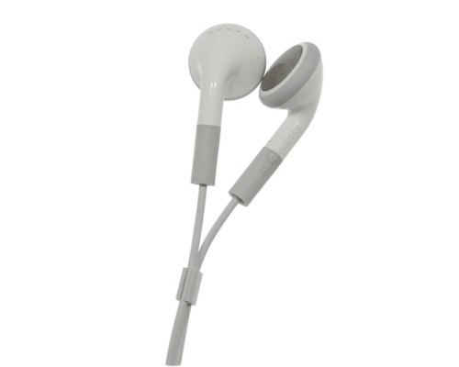
Whose earphones are they?
They are Jane’s earphones.
earphones
Jane

Slide 7
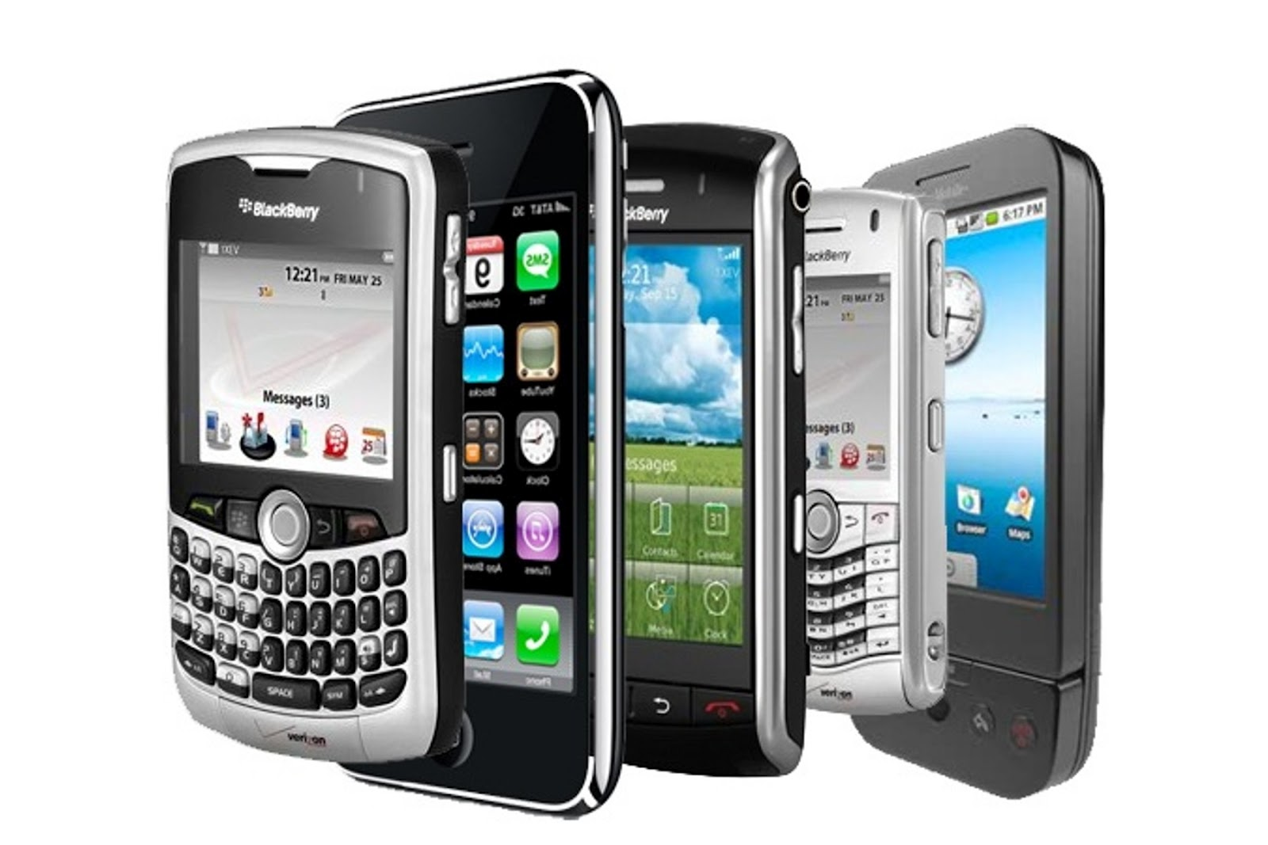
Whose cellphones are they?
They are the children’s cellphones.
the children
cellphones
mobile phones

Slide 8
Whose cellphones are they?
They are my parents' cellphones.
my parents
cellphones
mobile phones

Slide 9
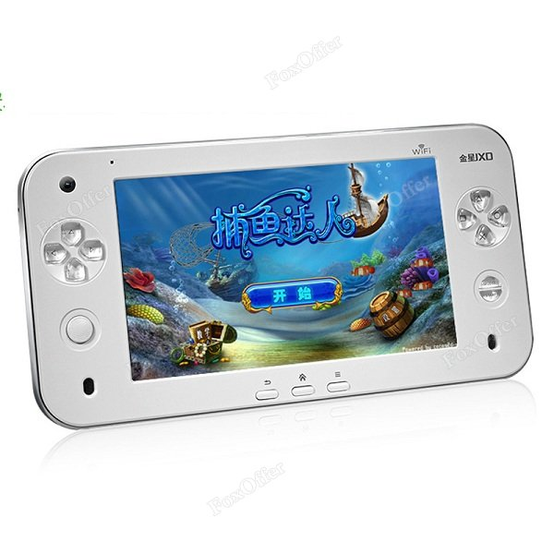
Whose video game console is it ?
It's Bob's video game console.
BOB
a video game console

